Slide 1
Statewide Analysis of Bicycle Crashes in North Carolina
Prepared By:
Matt Dardari
Preethika Gajendran
Rashi Waghray

Slide 2

Project Objectives
Study overall statewide bicycle crash patterns and trends in North Carolina.
Perform descriptive trend analysis of crashes based on the following factors:
Environmental factors
Bicyclist-related factors
Crash location
Motorist / Motor Vehicle-related factors
Roadway Characteristics
Identify bicycle crash hot spots/cities within the state
Identify danger zones based on crashes that resulted in fatalities

Slide 3

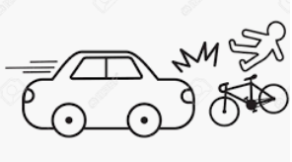
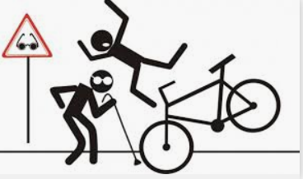
Dataset Used for Analysis
https://www.chapelhillopendata.org/
Maps the locations of crashes involving bicyclists in North Carolina from Jan 2007-Dec 2018
Police-reported bicycle collisions with motor vehicles
Crashes occurred on:
the public roadway network
public vehicular areas
private properties (if reported)
Exclusions:
Crash identification numbers
Fatality count

Slide 4
Data Cleaning Process
Grouped similar values:
Crash Group
Road Conditions
Binning items into categories:
Time of Day
Renaming Column Headers
Dropping unknown/missing/unwanted values during analysis

Slide 5
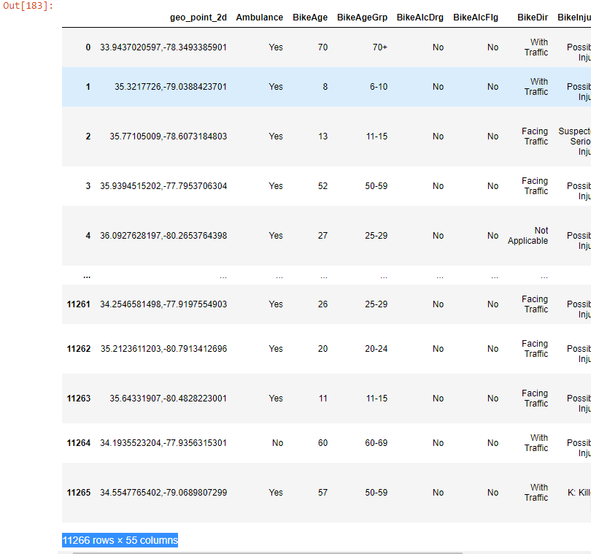
Basic Data Analysis
Total reported crashes = 11266
All 100 counties within the State
327 cities
Crash sites not within the bounds of these 327 cities are categorized as “Rural” sites

Slide 6
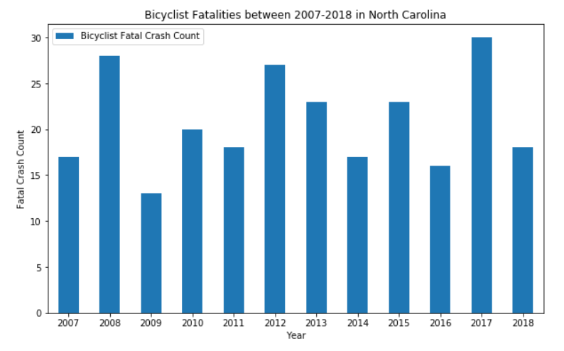
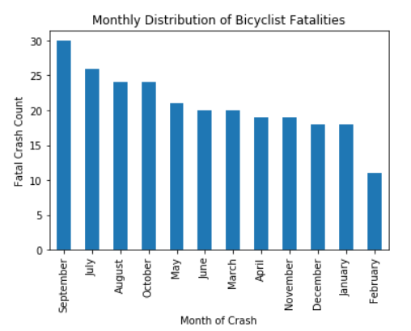
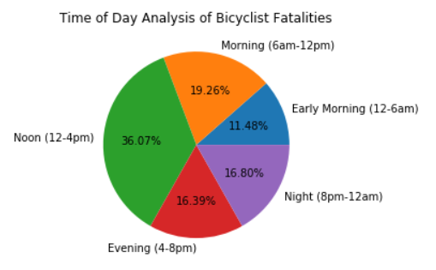
Trend Analysis – Bicyclist Fatality Trends – WHEN?
Between 2007-2018,
About 250 crashes resulted in the death of a biker but
Only 2 crashes resulted in the death of a motorist
Yearly Average = 20 fatal crashes / year
Most (30) bicyclist fatalities occurred in 2017
Almost 50% of fatal crashes happened between Jun – Oct
More than a third (36%) of the fatal crashes occurred in the afternoon (12-4pm)

Slide 7
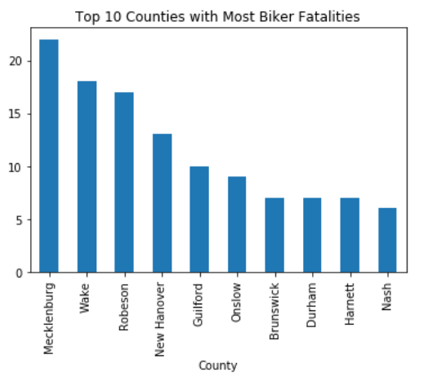
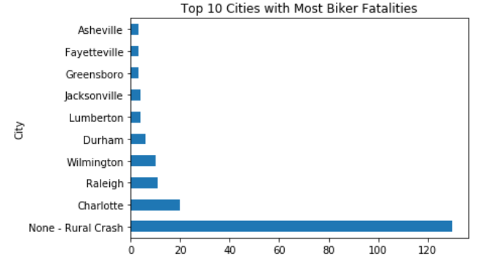
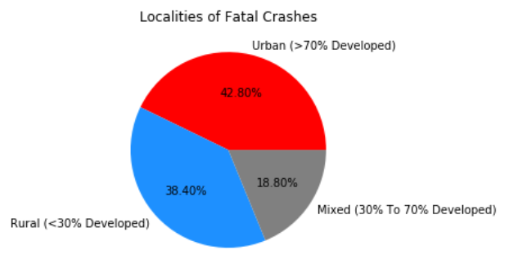
Trend Analysis – Bicyclist Fatality Trends – WHERE?
On average there were about 2.5 fatal crashes per County
About 46% of the fatal crashes occur in 10 cities across the state

Slide 8
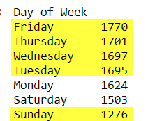
Least crashes on Sundays (due to low traffic?)
Other days are almost equal

Slide 9
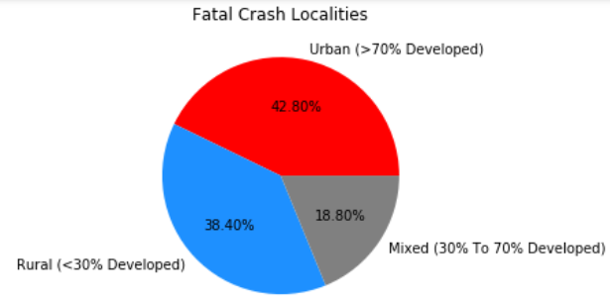
Trend Analysis – Bicyclist Fatality Trends – WHERE?
Fatal Crashes were distributed almost uniformly between Urban and Rural localities

Slide 10
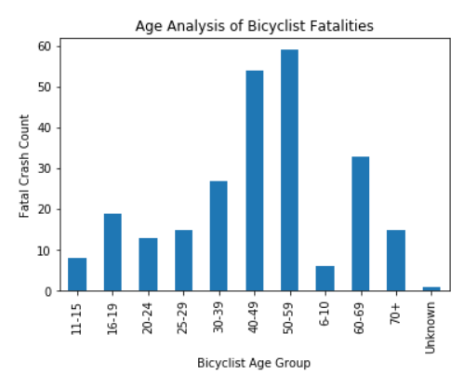
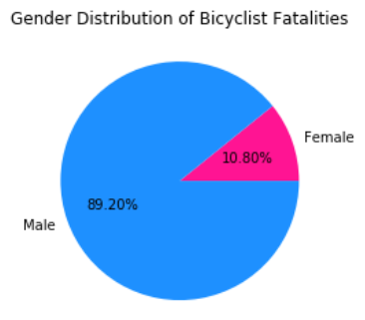
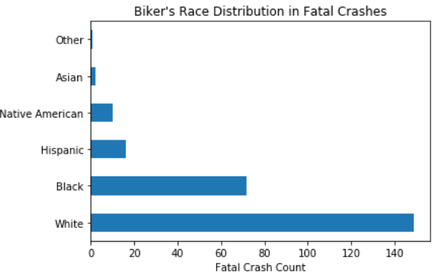
Trend Analysis – Bicyclist Fatality Trends – WHO?
Crashes involving younger bicyclists (<65 years) resulted in far more (80%) fatalities compared to elder bicyclists (>65 years)
Crashes involving male bicyclists (89%) resulted in more fatalities compared to crashes involving female bicyclists
Majority of the bikers involved in fatal crashes were Caucasians (60%)

Slide 11
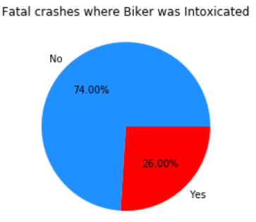
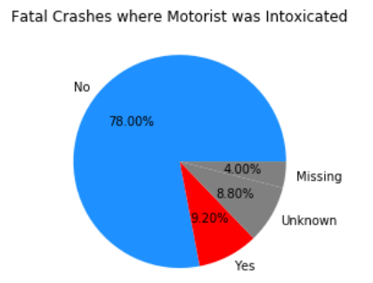
Trend Analysis – Bicyclist Fatality Trends – WHY?
A quarter of the fatal crashes had intoxicated bikers
About a tenth of the fatal crashes had intoxicated motorist’s

Slide 12
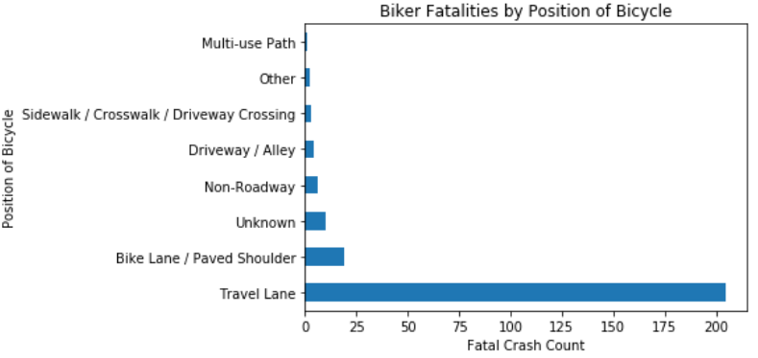
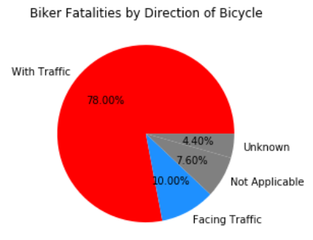
Trend Analysis – Bicyclist Fatality Trends – WHY?
Vast majority of fatal crashes (80%) occurred when the bicycle was in the travel lanes
Vast majority of fatal crashes (78%) occurred when the bicycle was in the same direction as the normal traffic

Slide 13
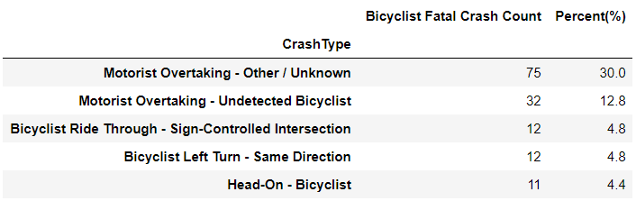
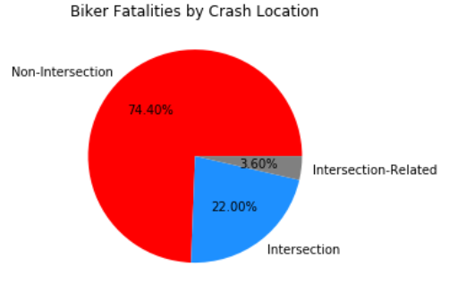
Trend Analysis – Bicyclist Fatality Trends – WHY?
Vast majority of fatal crashes happened when the bicycles were not at a traffic intersection (74%)
About 42% of the fatal crashes were due to a motorist overtaking the bicyclist

Slide 14
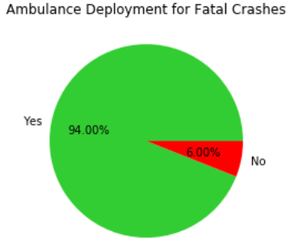
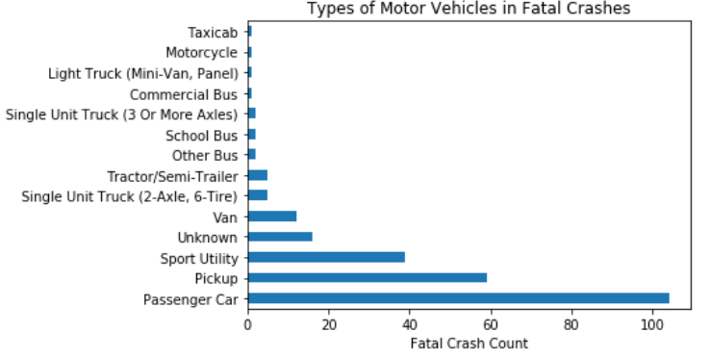
Trend Analysis – Bicyclist Fatality Trends – WHY?
An ambulance was deployed for 94% of the crashes that resulted in fatalities

Slide 15
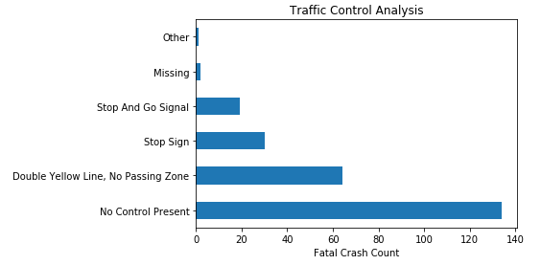
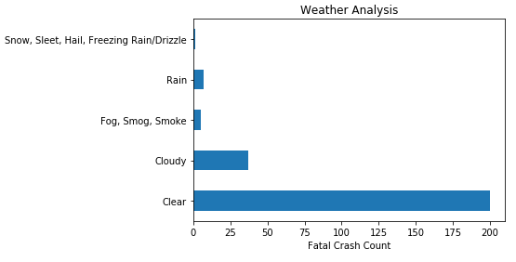
Trend Analysis – Bicyclist Fatality Trends – WHY?

Slide 16
Conclusion
You are more likely to get into a FATAL crash if:
- you are a male Caucasian between 50-60 years of age riding a bicycle in a travel lane with traffic,

Slide 17
Next Steps
Injury Analysis
Analysis of use of helmets
Find correlation between county/city population and bicycle crashes

Slide 18
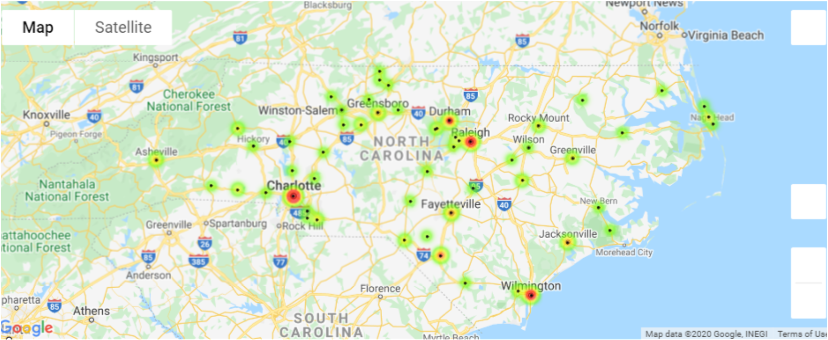
Fatal Cities

Slide 19


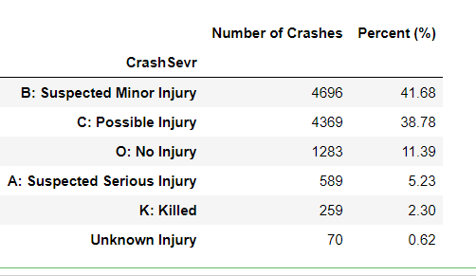
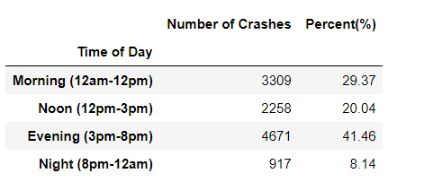
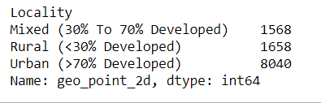
Total crashes: 11266
Number of Counties : 100
Number of Cities: 327
Only 7% involved intoxicated Bikers
14.74% were Hit-n-Run cases
Nighttime bicycle crashes resulted in more fatalities compared to daytime crashes.
71% were in urban areas

Slide 20
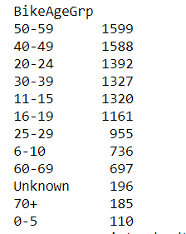
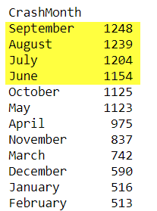
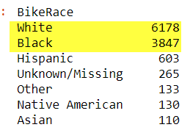
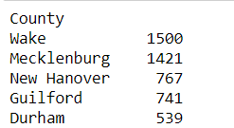
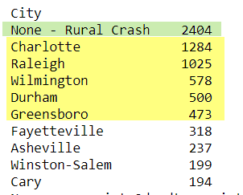

Most crashes happen in Summer Months (Jun-Sep)
More than half are white bikers (54.83%)
Age grouping
Top 5 Counties with most crashes
About 1/5th crashes are from rural areas
Top 5 cities with most crashes are:
Gender grouping

